Slide 1
Promises, async/await, and axios requests in Node.js and Express

Slide 2
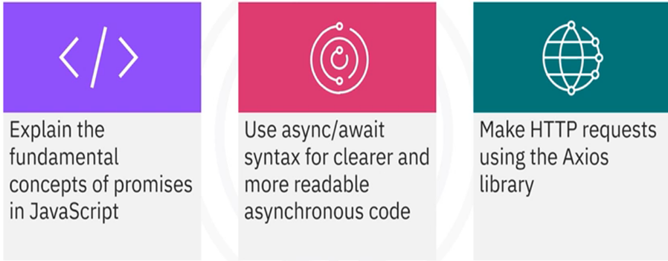
What you will learn

Slide 3

Introduction
• Responsive and performant
• Important for web applications
• Enhance performance and user
experience

Slide 4

Promise
• Represents the eventual
completion or failure
• Chains operations for better
readability and manageability

Slide 5
States of a promise
The initial state,is neither fulfilled nor rejected
• Pending: Initial state, neither
fulfilled nor rejected
• Fulfilled: Operation completed
successfully
• Rejected: Operation failed
pending
States of a
promise
The operation completed successfully
fulfilled
Rejected
the operation failed

Slide 6
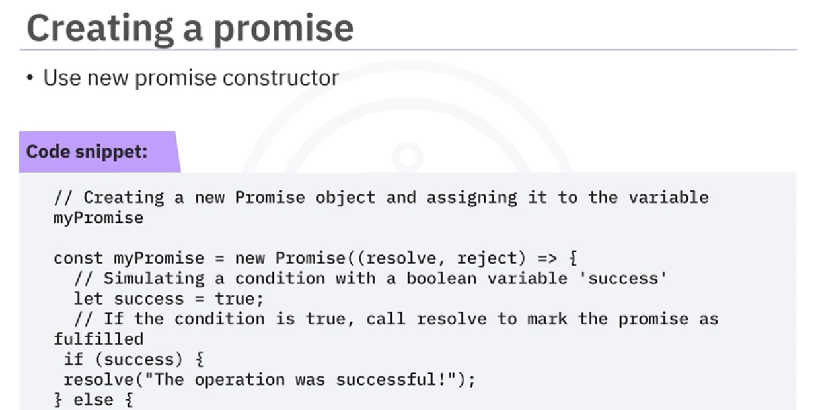

Slide 7
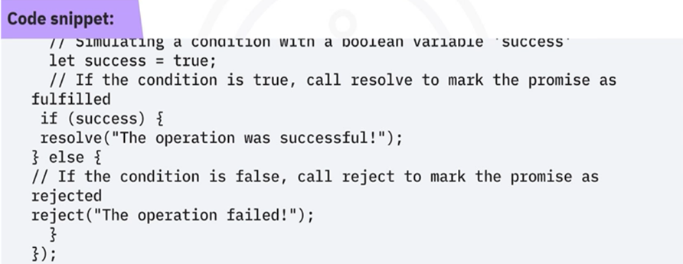
Creating a promise
• Use new promise constructor
• Handle success and failure with resolve and reject functions

Slide 8
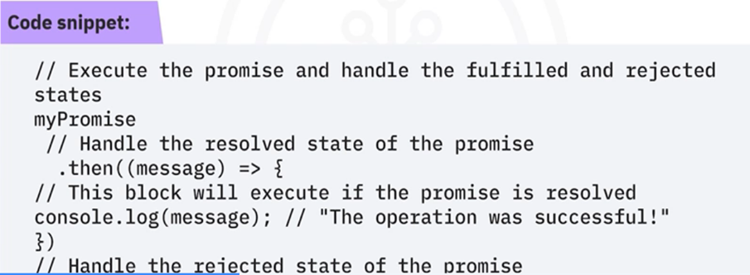
Using promises with .then() and .catch()
• Handle success with .then()
• Handle errors with .catch()
• Chain multiple asynchronous operations

Slide 9
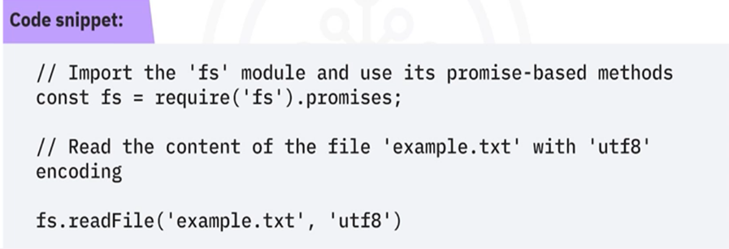
Reading a file with promises
fs.promises module:
• Reads a file
• Provides promise-based methods for file system operations

Slide 10

Async/await in JavaScript
• Async/await simplifies promises; resembles synchronous code
• Async function returns a promise
• Await pauses execution until a promise resolves or rejects

Slide 11
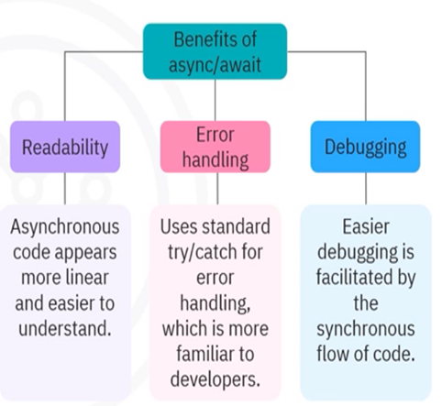
Benefits of async/await
• Enhances readability
• Offers familiar error handling
• Easier debugging

Slide 12
Using async/await function
• Simulates a conditional operation
• Returns a success message or throws an error
• Uses await to call the async function
• Handles result/errors with try and catch
• Simpler than .then() and .catch() chains

Slide 13
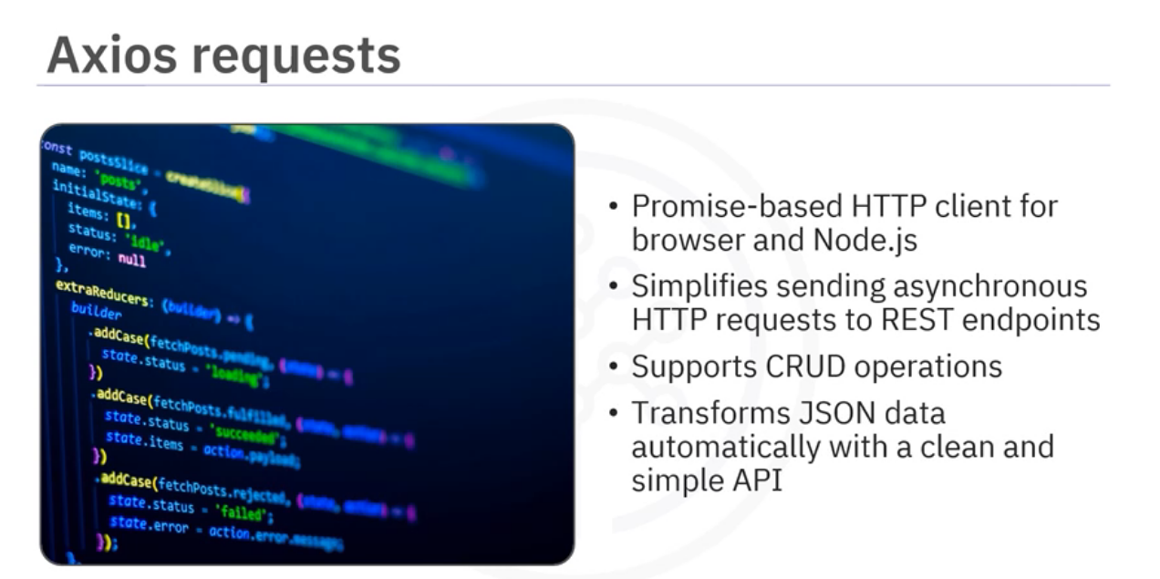

Slide 14
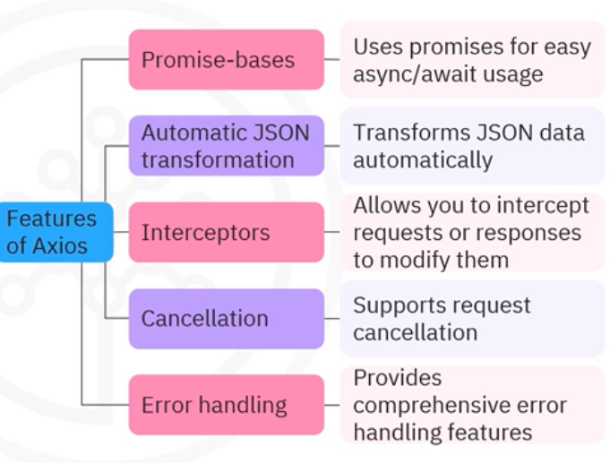
Features of Axios
• Promise-based
• Automatic JSON
transformation
• Interceptors
• Cancellation
• Error handling

Slide 15
Using Axios to make GET request
• Install Axios using command npm install axios
• Use Axios to make HTTP GET requests
• Use axios.get method to access the data with response.data

Slide 16
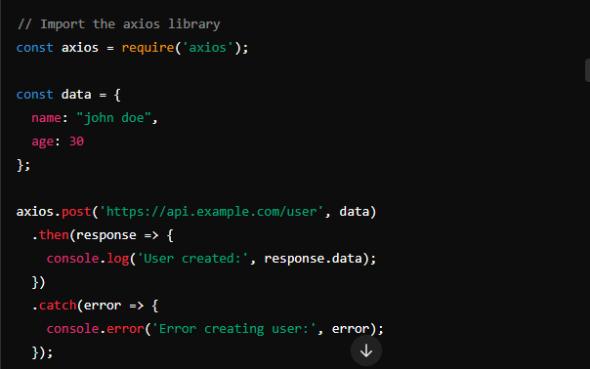
Using Axios to make POST request
• Import Axios for HTTP requests
• Create user data object for POST request
• Use axios.post to send data to the server
• Log response data on success
• Log error message on failure

Slide 17
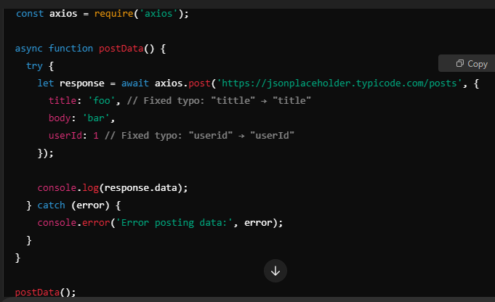
Using async/await with Axios
• Async/await handles HTTP requests efficiently
• Await pauses function execution for POST request
• Result is handled inside the try block

Slide 18
Recap
• Asynchronous programming boosts web application performance
and responsiveness.
• Promises enhance code readability and management with operation
chaining.
• Async/await makes asynchronous code look synchronous and easier
to write.
• Axios simplifies HTTP requests to APIs in JavaScript.

